Slide 1


21LEM301T - Indian Art Form
Inspired Art Form : Madhubani Paintings
By: Ponnuri Aniruddha
RA2112704010015

Slide 2
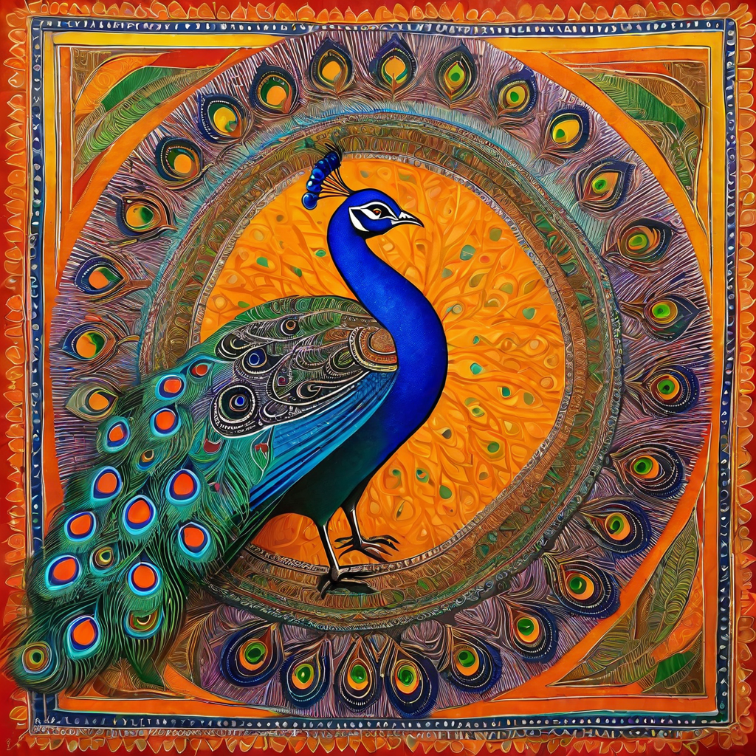
Introduction
Madhubani paintings are a traditional art form originating from the Mithila region of Bihar, India. The paintings are known for their vibrant colors and intricate designs, often depicting scenes from Hindu mythology and nature.
Madhubani paintings are believed to have originated in the 6th century BC, when women in the Mithila region began creating intricate designs on the walls of their homes using natural dyes and pigments.
Over time, Madhubani paintings evolved into a distinct art form, with each village and family developing their own unique style and techniques.

Slide 3
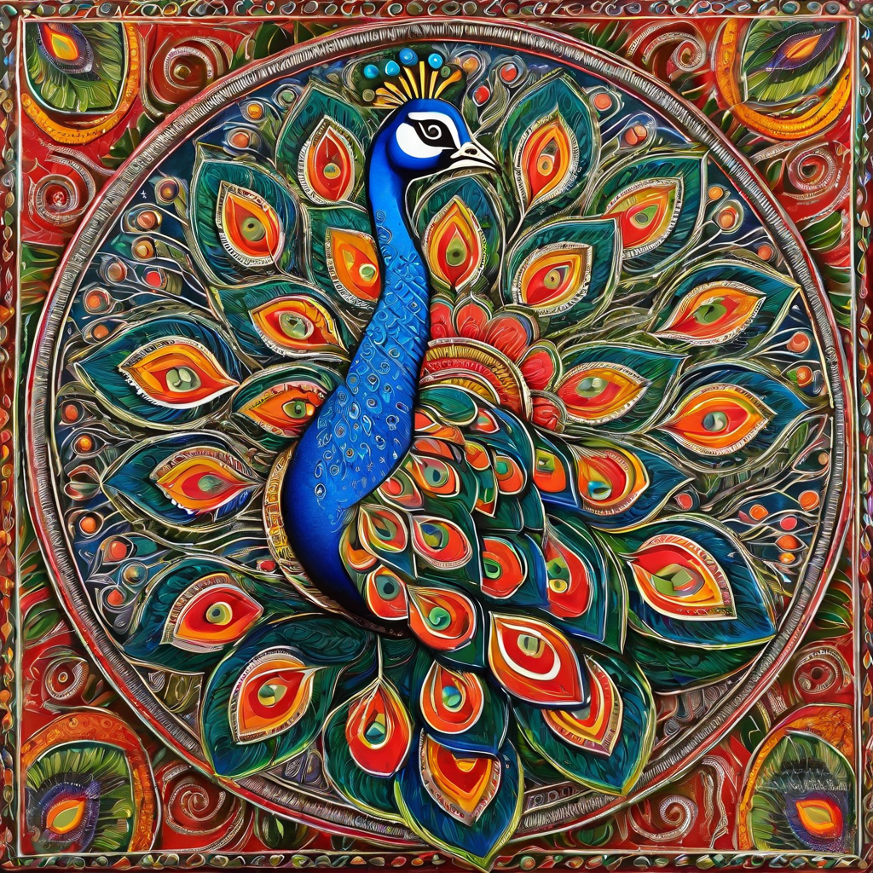
History of Madhubani Paintings
Madhubani paintings originated in the Mithila region of Bihar, India, and have been a part of the local culture for centuries. The art form was traditionally practiced by women, who would paint intricate designs on the walls of their homes during auspicious occasions such as weddings and festivals. It was only in the 1960s that the paintings gained recognition as a standalone art form, thanks to the efforts of a few local artists and scholars who brought it to the attention of the wider world.

Slide 4
Locality and Unique Features
A Local Art Form
Distinctive Style and Techniques
Madhubani paintings originated in the Mithila region of Bihar, India. The art form has been passed down through generations of women in the community, and is traditionally created on walls and floors of homes for special occasions such as weddings and festivals.
Madhubani paintings are known for their vibrant colors and intricate designs. The artists use natural dyes and pigments, and employ techniques such as double line drawing and filling in with cross-hatching. The style varies between different villages, with each community having its own unique approach to the art form.

Slide 5
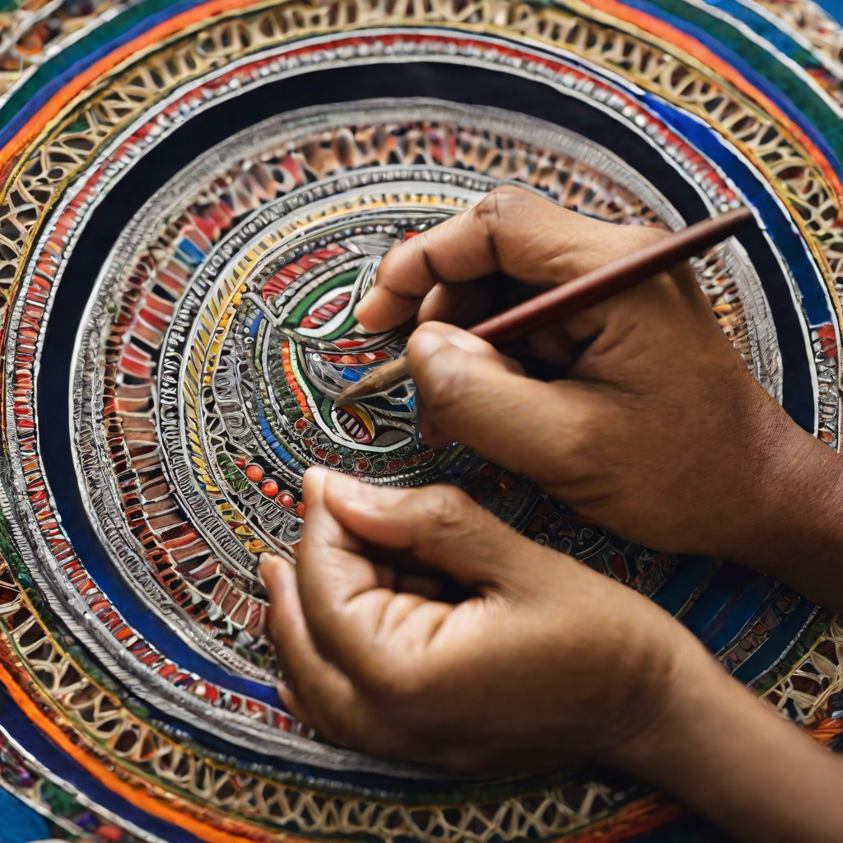
Requirements
Madhubani paintings require a specific set of materials and tools to create the distinctive style and vibrant colors.
Materials
Handmade paper or cloth canvas
Natural pigments made from flowers, leaves, and minerals
Brushes made from bamboo sticks or cotton wool
Techniques
Madhubani paintings are created using a variety of techniques, including:
Finger painting
Brush painting
Dot painting

Slide 6
Madhubani Style and Techniques
Materials and Tools
Techniques
Traditionally, Madhubani paintings were created using natural materials such as bamboo sticks, cotton cloth, and natural pigments made from flowers, leaves, and other organic matter. Today, many artists also use modern materials such as acrylic paints and canvas.
Madhubani paintings are typically created using one of two techniques: the Kachni style or the Bharni style. The Kachni style involves creating outlines of the design using a bamboo stick or pen, and then filling in the design with color. The Bharni style involves filling in the entire design with color, and then adding details and outlines on top of the base layer.

Slide 7
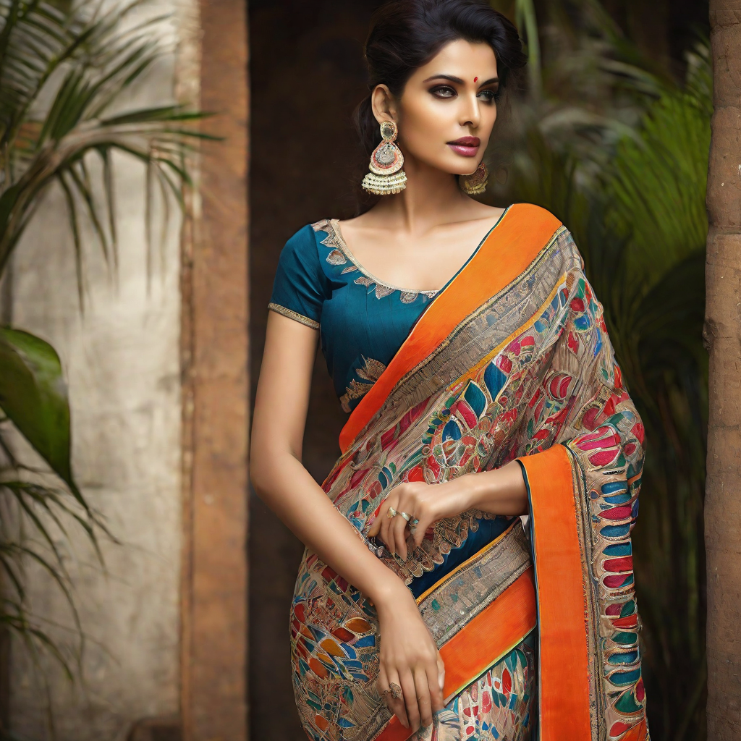
Madhubani in Fashion
Madhubani paintings have been incorporated into fashion in a variety of ways, including on sarees, dresses, and scarves. The intricate designs and vibrant colors make for stunning statement pieces that celebrate India's rich cultural heritage.

Slide 8
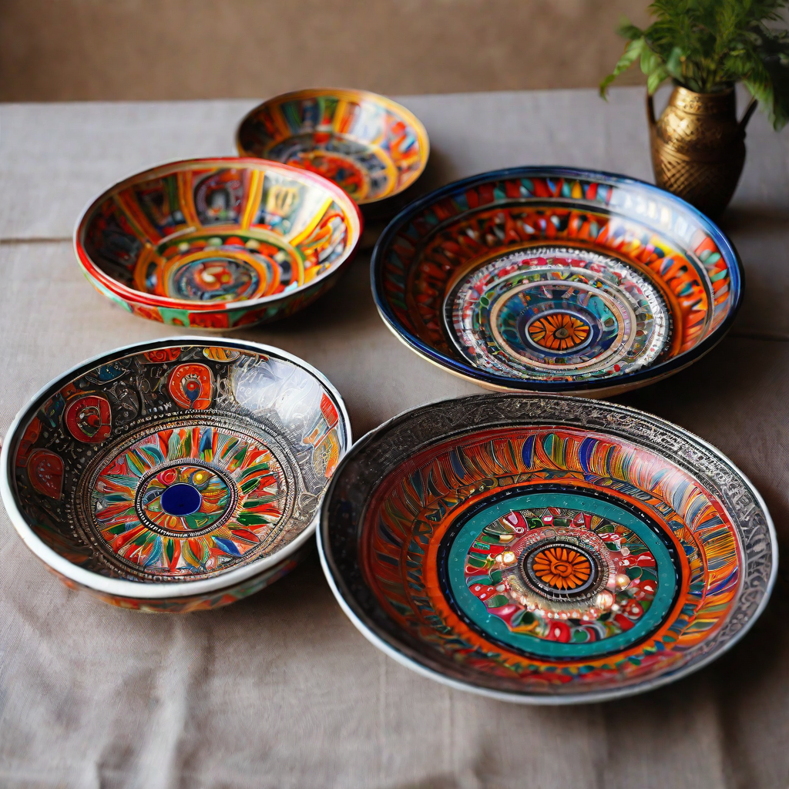
Madhubani in Home Decor
Madhubani paintings are also popular in home decor, with hand-painted cushion covers, bedspreads, and ceramic plates being especially popular. These items add a touch of traditional Indian artistry to any home and are often used to create a bohemian or eclectic aesthetic.

Slide 9
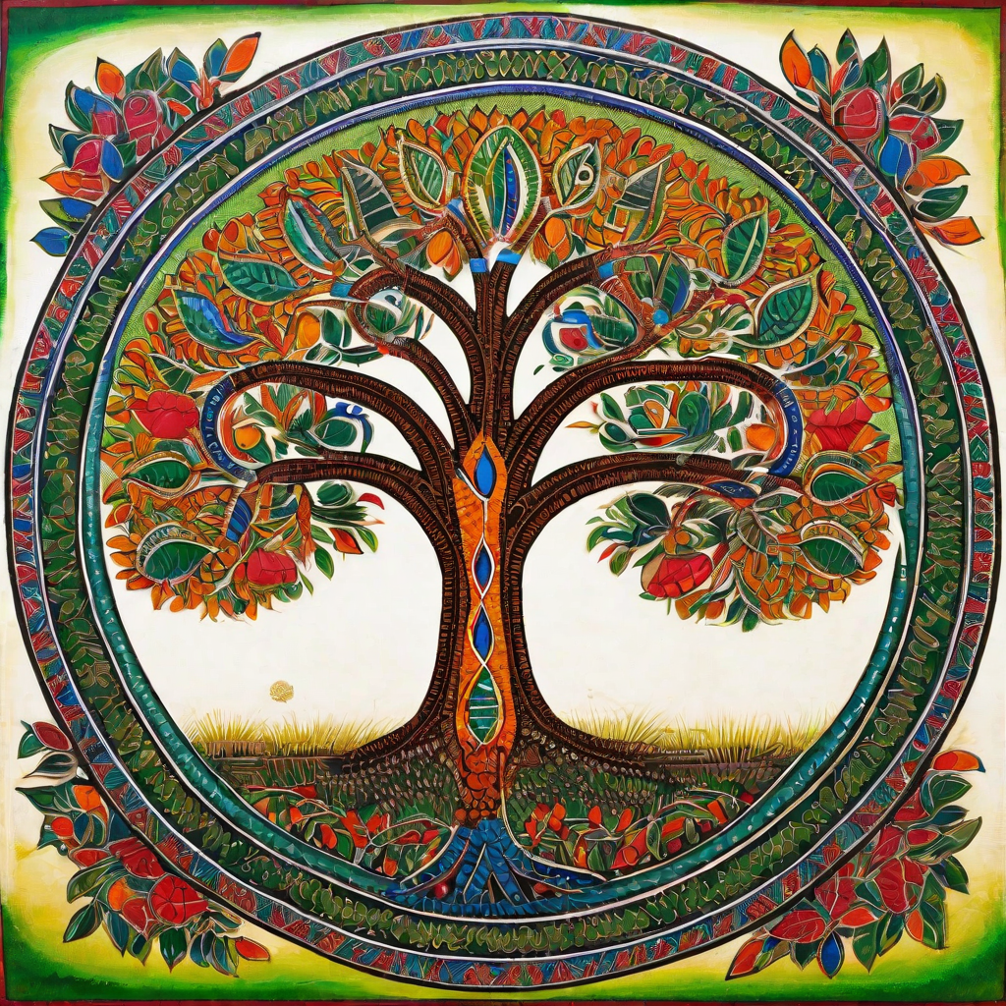
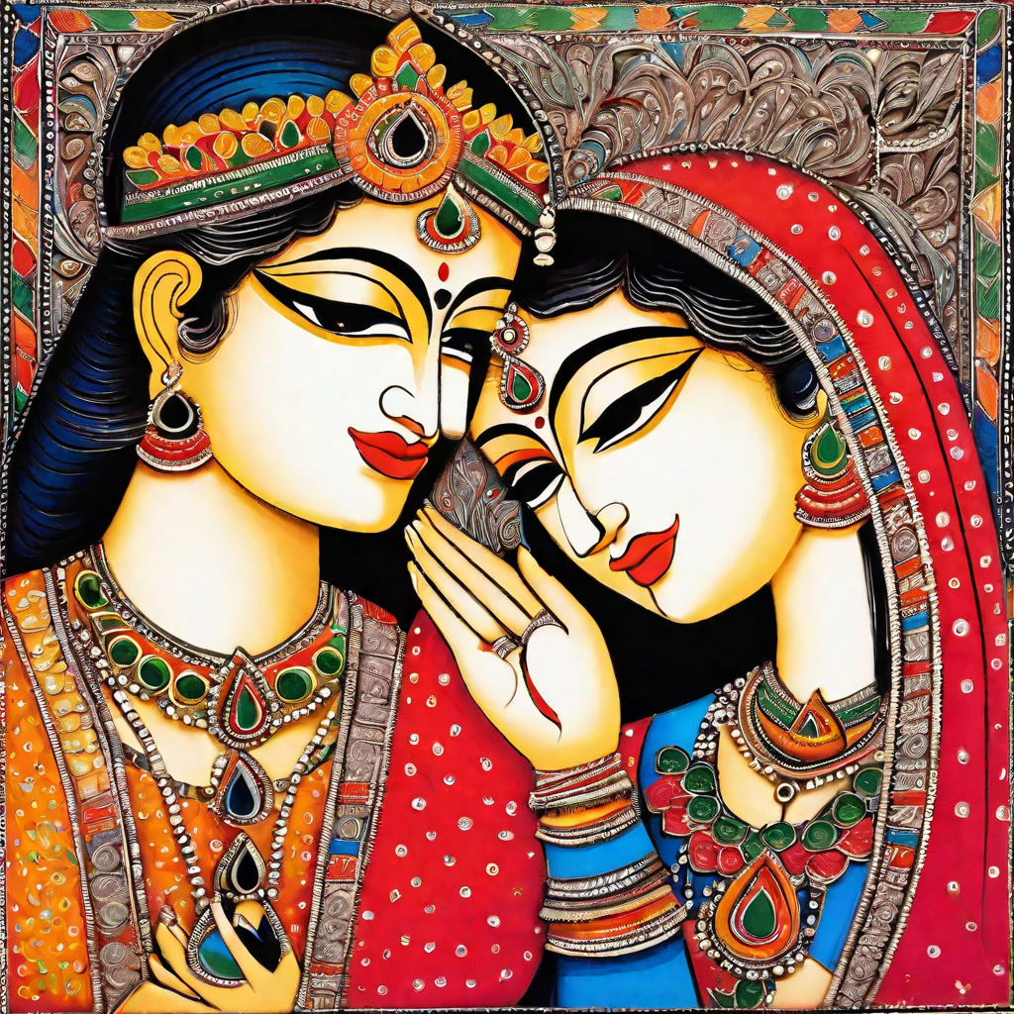
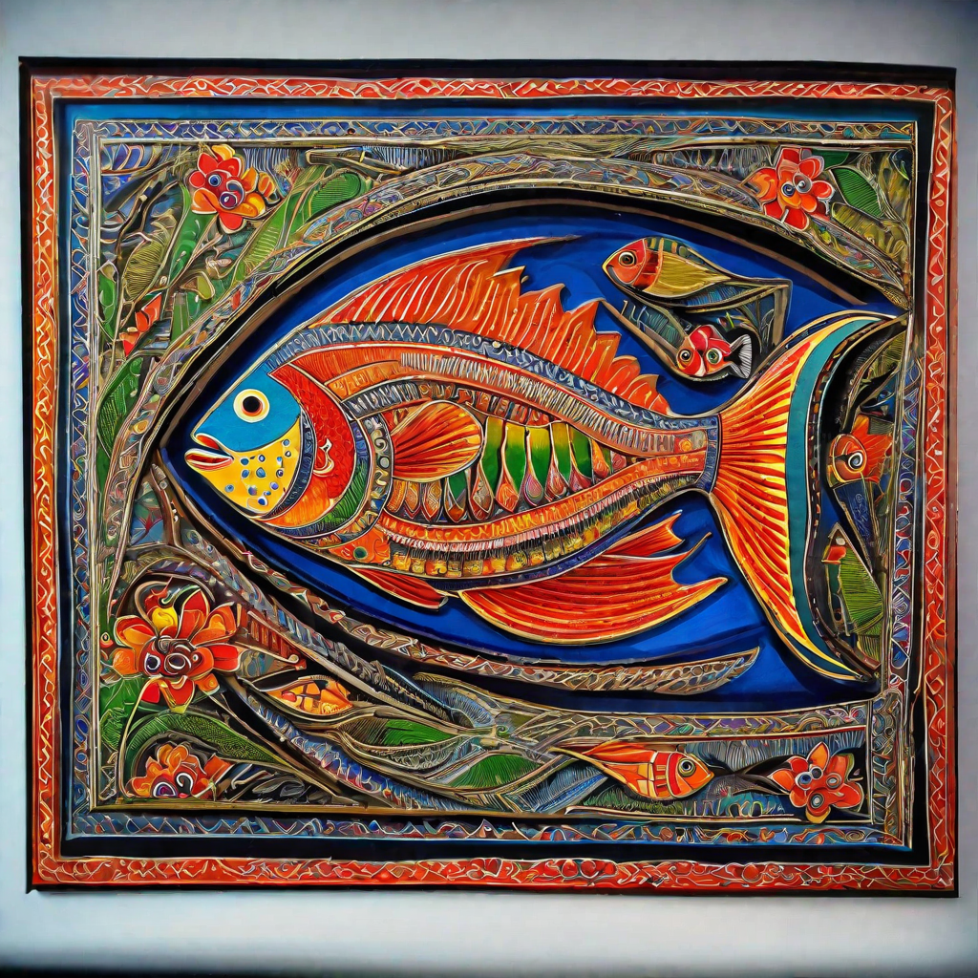
Photos

Slide 10
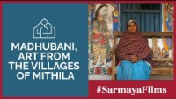
Videos

